Slide 1


High Performance Python Lab Term 2 2019/2020
Hipercore Lab
Instructors: Sergey Rykovanov, Daniil Stefonishin
Teaching Assistants: Rishat Zagidullin, Iurii Minin

Slide 2
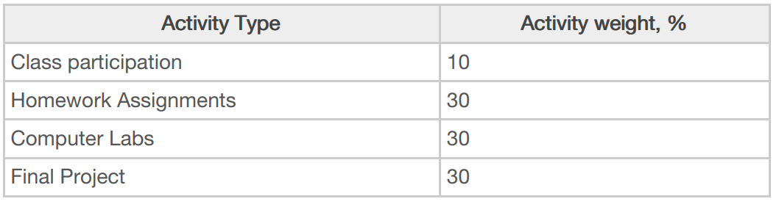
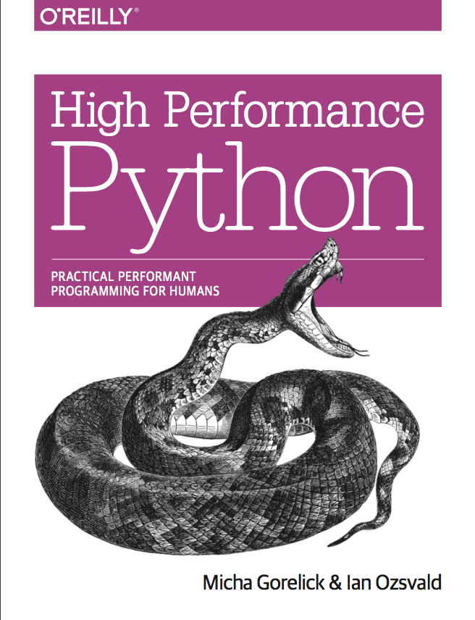
Course logistics
(Wednesdays 12:30-15:30 lectures/practical sessions
(Thursdays 9:00-12:00 lectures/practical sessions
Recommended textbooks:
Micha Gorelick
Ian Ozsvald
“High Performance Python” Python”
Other resources
stackoverflow.com
medium.com
coursera.org
udacity.com
google.com
your fellows and TAs

Slide 3
Course logistics
Prerequisites:
Laptop with Linux or VM with Linux
Basic knowledge of Python
Great mood, smiling and asking questions
Preferables:
Knowledge of Unix-like systems (working in terminal)
Deep knowledge of Python, knowledge of C/C++
Jupyter Notebook, numpy, scipy, matplotlib knowledge and have it already installed
Basic undergrad mathematics (calculus, linear algebra, ODEs and PDEs)
You will have a chance to work on the part of one of Russia’s most powerful supercomputers “Zhores”.

Slide 4
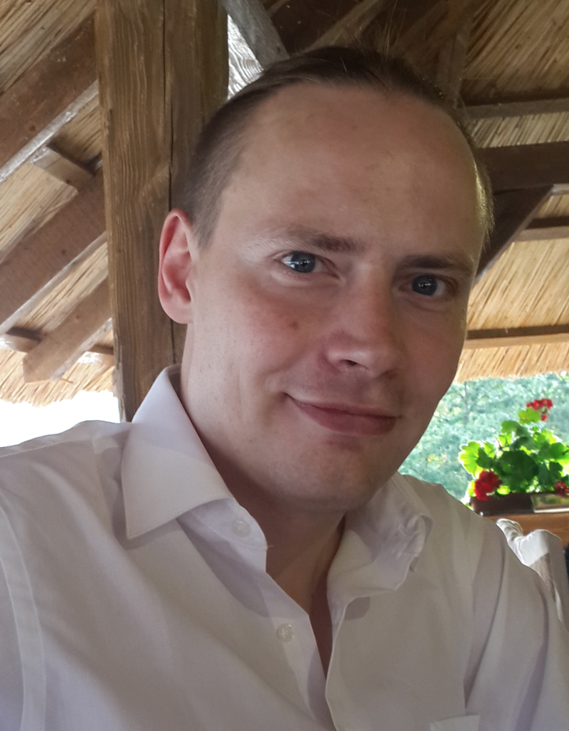
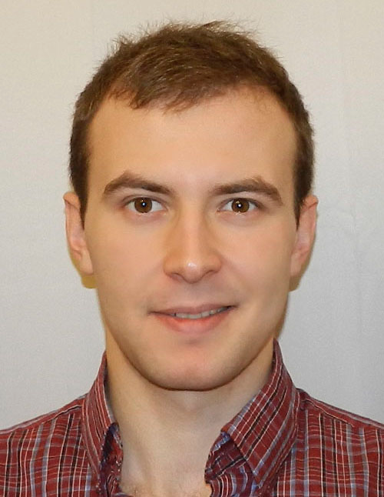
Instructors
Associate Professor
Sergey Rykovanov
Junior Research Scientist
Daniil Stefonishin
2000-2006 Lomonosov Moscow State University, Physics Faculty
2006-2009 PhD from Ludwig-Maximilians University Munich, Germany (Theoretical and computational plasma physics)
2009-2018 Postdoc at Ludwig-Maximilians University Munich, Lawrence Berkeley National Laboratory USA, Group Leader at Helmholtz Institute Jena, Germany
July 2018-… Skoltech
2009-2014 Lomonosov Moscow State University, Faculty of Computational Mathematics and Cybernetics
2014-2018 PhD student, MSU and Institute of Numerical Mathematics, Russian Academy of Sciences
October 2018-... Skoltech
s.rykovanov@skoltech.ru
d.stefonishin@skoltech.ru

Slide 5
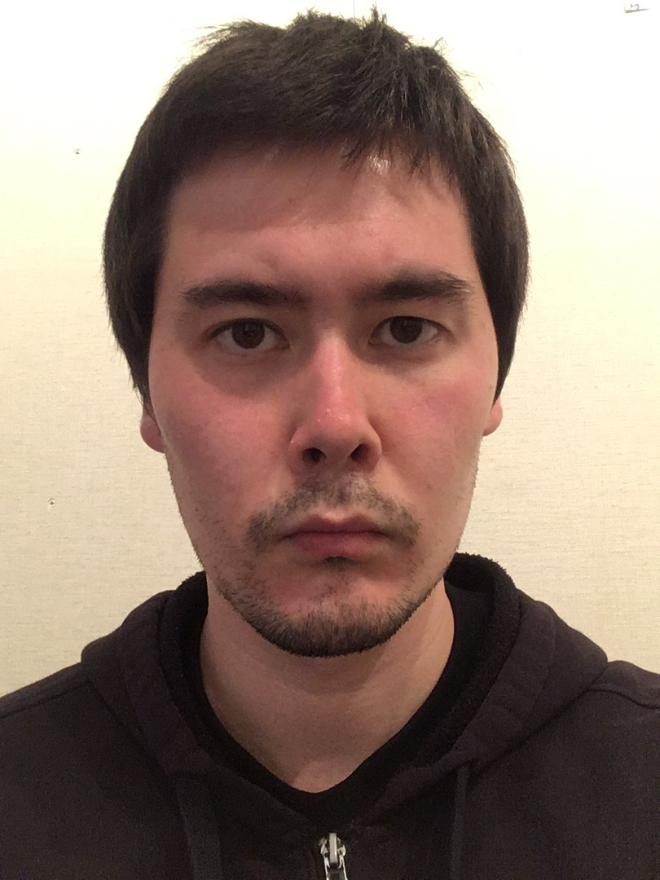
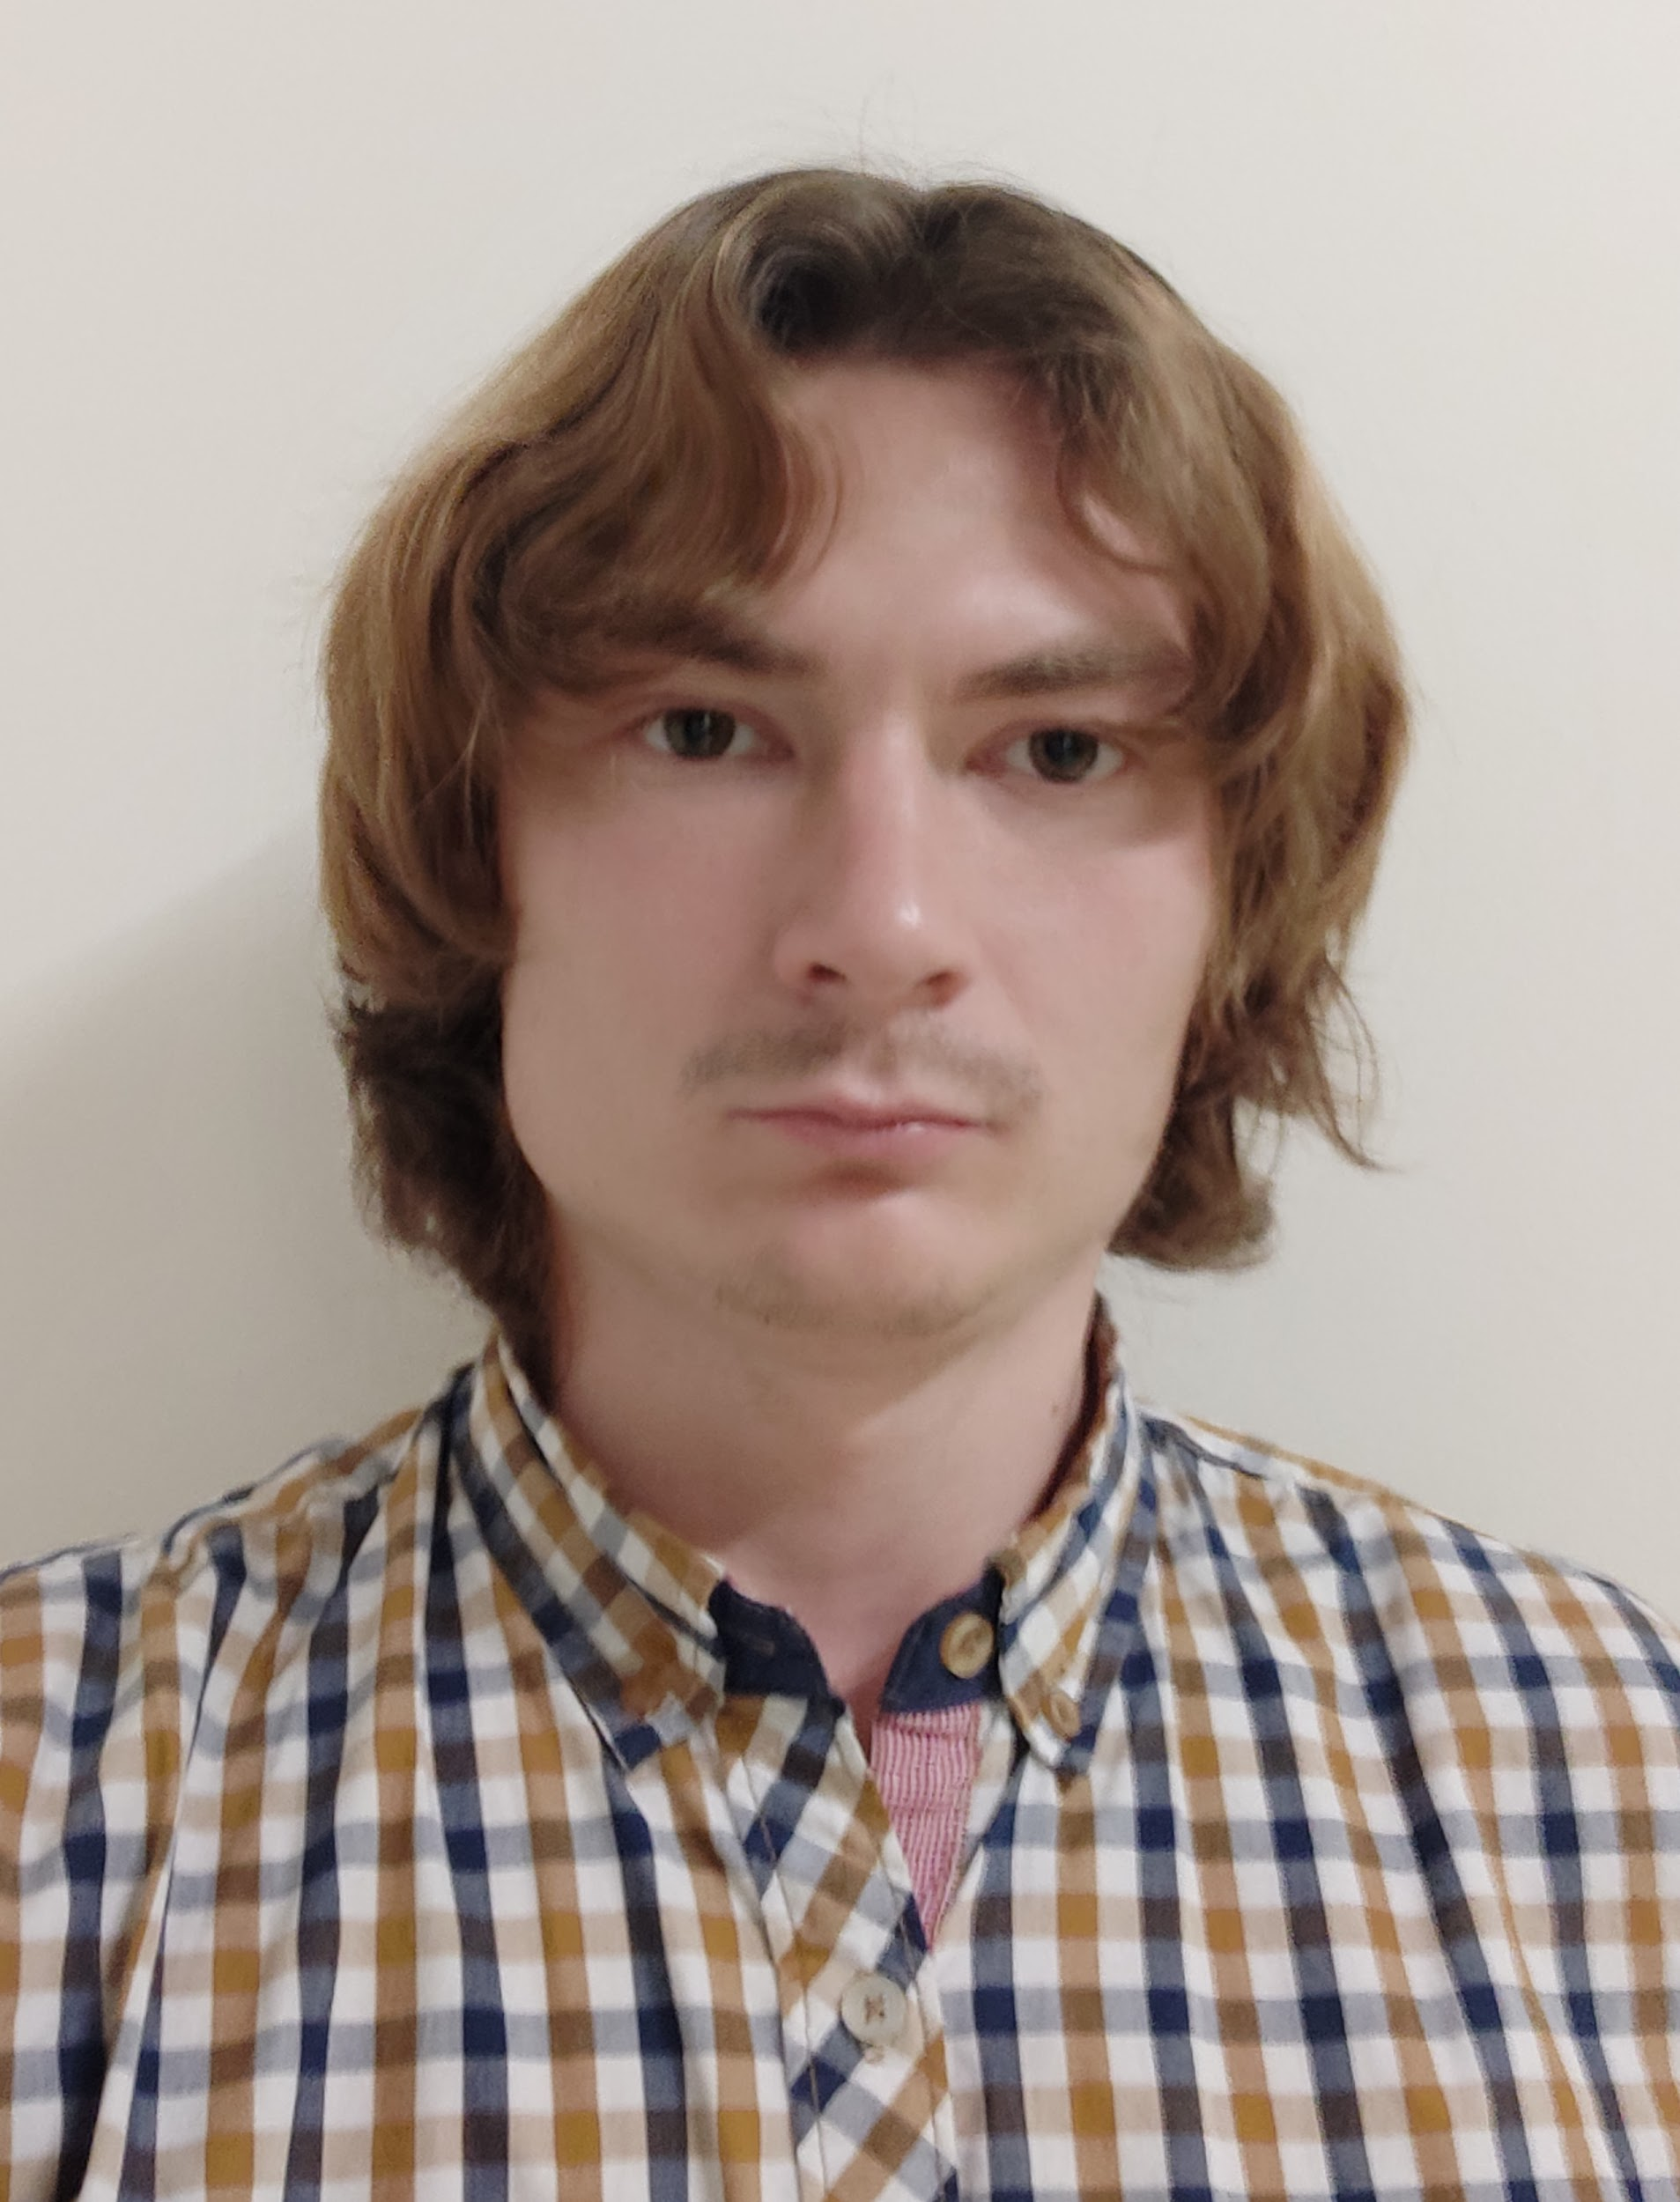
Teaching Assistants
Research Intern
Rishat Zagidullin
PhD Student
Iurii Minin
2012-2016 Higher School of Economics, BSc.
2016-2018 Moscow State University, MSc.
2019-now Skoltech (CDISE), PhD student
2013-2019 Phystech (Department of Radio-Engineering and Cybernetics, Department of Physics and Quantum Electronics), BSc and MSc
2017-2019 Skoltech (IST), MSc
2019-2019 Skoltech, Research Intern
2019 - now Skoltech (CDISE), PhD student
r.zagidullin@skoltech.ru
iurii.minin@skoltech.ru

Slide 6
Goals of the course
Not to be afraid of programming (in Python and overall)
Not to be afraid of supercomputers.
Be able to write parallel programs on modern multi-core CPUs and GPUs.
Learn how to use large computing infrastructure.
Have fun learning.
Finish with a cool project that involves Python code optimization.

Slide 7

Hipercore Lab
High Performance Computing Research and Education

Slide 8
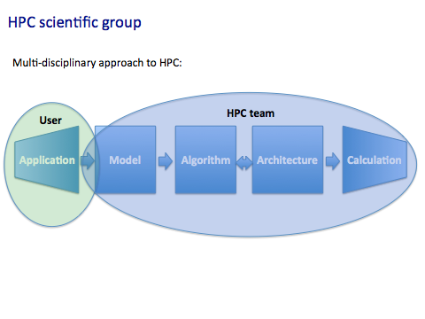

Slide 9
HPC scientific group objectives
Education of the world class specialists in a wide range of topics related to HPC, distributed machine learning, Big Data and AI;
Contributing research, education, innovation resources;
Research in data-intensive engineering, applied mathematics, scientific and high performance programming, HPC & Big Data system administration, data visualization, innovation by using supercomputers, computation physics and others;
Establishing the multidisciplinary team able to solve a wide range of applied problems from different areas of science and engineering at different stages (from physical and mathematical models to development and parallelization of computer codes on modern supercomputers);
Attracting external funding;
Performing outreach, advertisement and education activities.

Slide 10
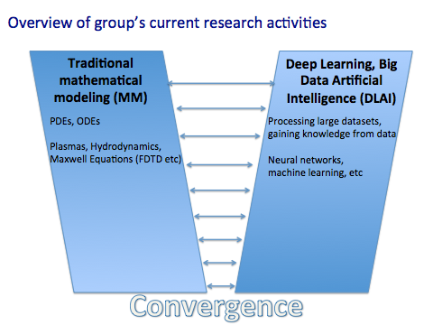

Slide 11
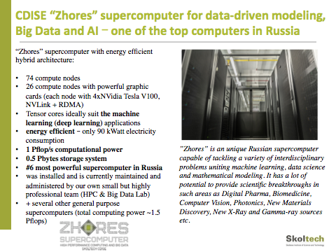

Slide 12



Slide 13
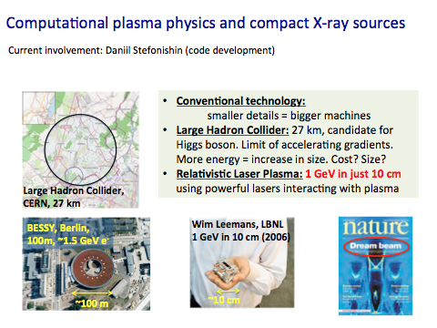

Slide 14
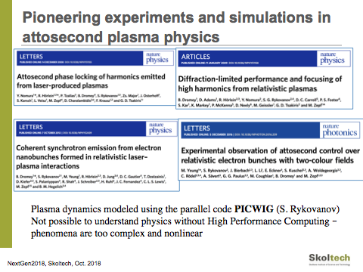

Slide 15


Slide 16
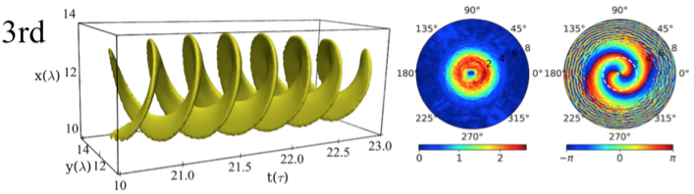
Numerical Photonics
Large variety of projects:
ML methods for photonics devices
Metasurfaces and nanophotonics
Nonlinear Schroedinger Equation for fiber lasers
Reinforcement learning for fiber laser stabilization
more

Slide 17
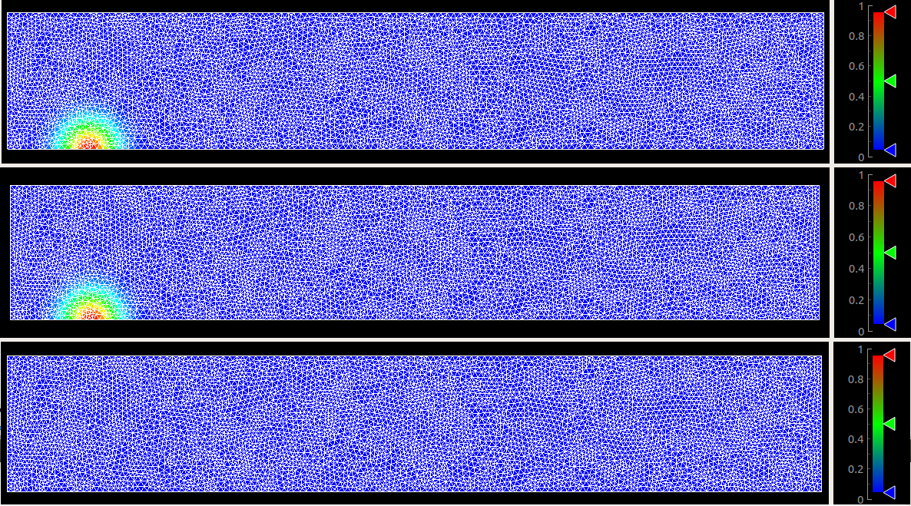
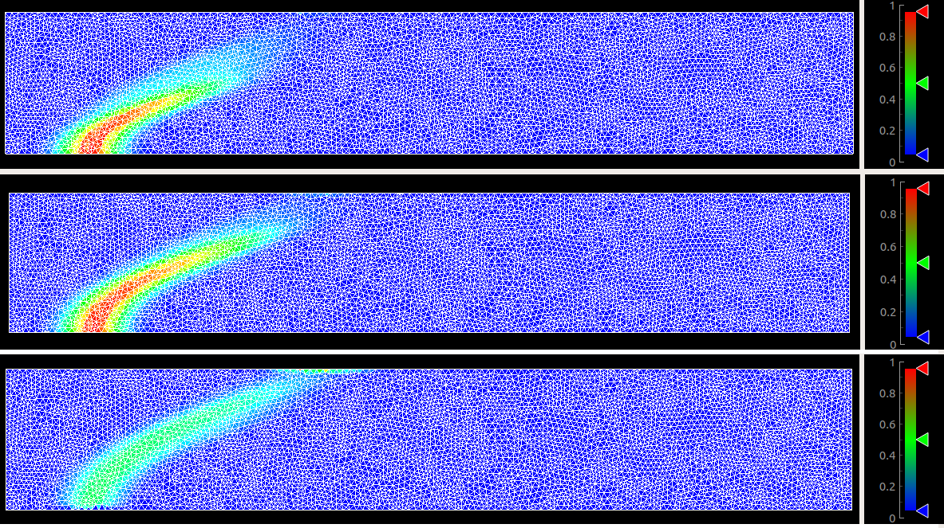
CFD of complex liquids
Used in simulating aerosols, oil & gas, river pollution, astrophysics, cosmetics

Slide 18
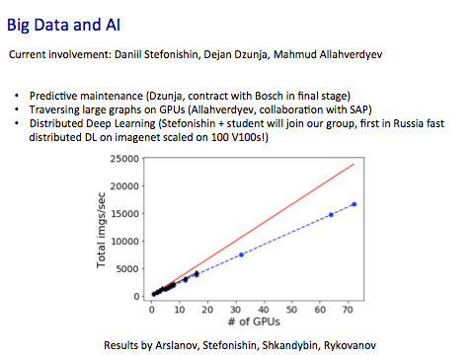

Slide 19
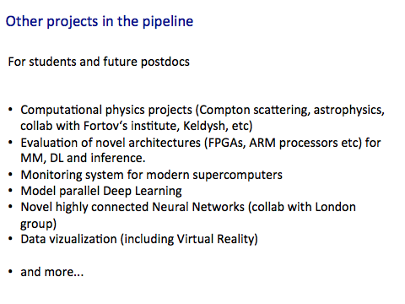
https://cdise-jira.skoltech.ru/conf/display/CE/Sergey+Rykovanov

Slide 20
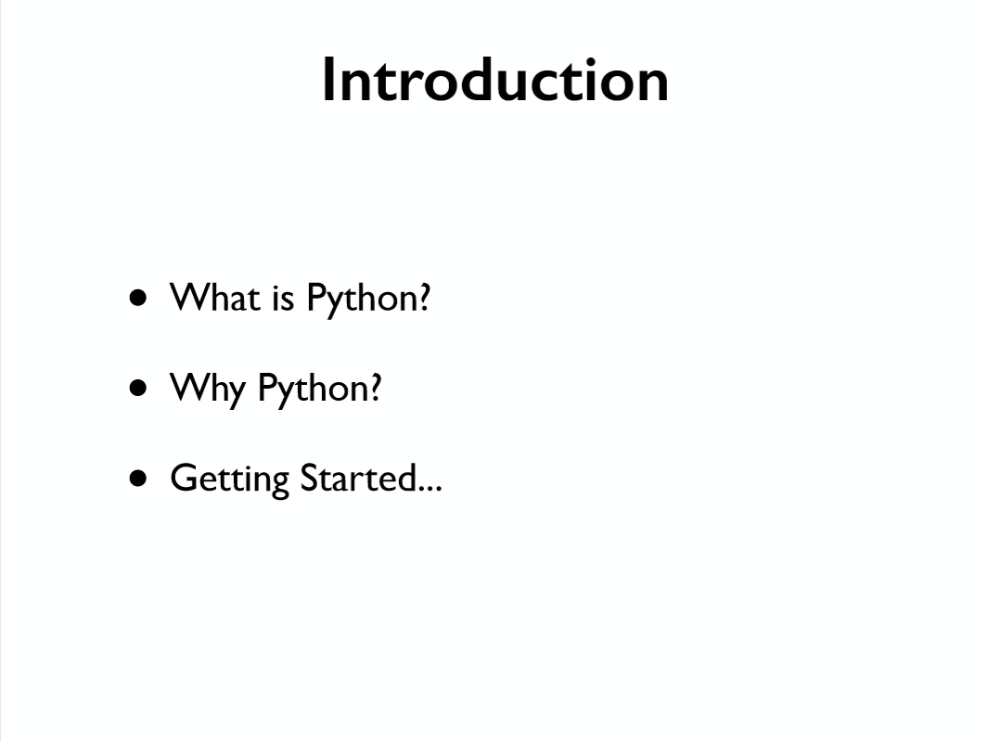

Slide 21
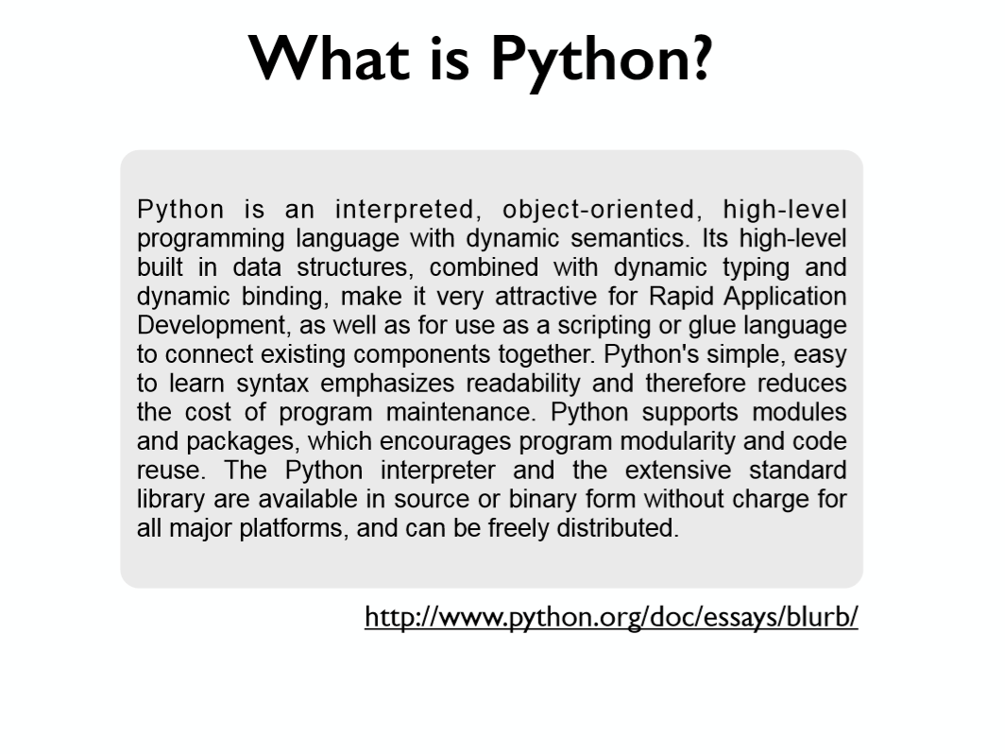

Slide 22
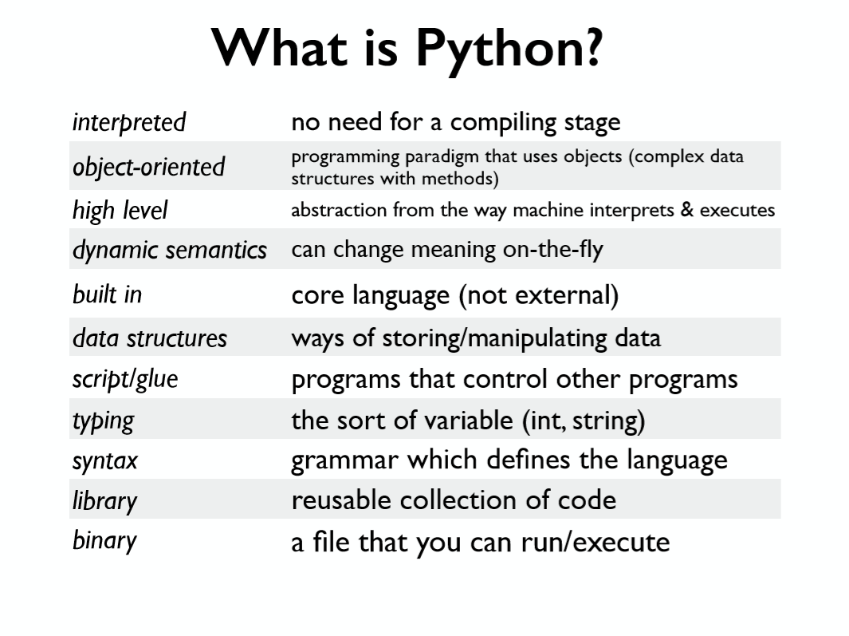

Slide 23
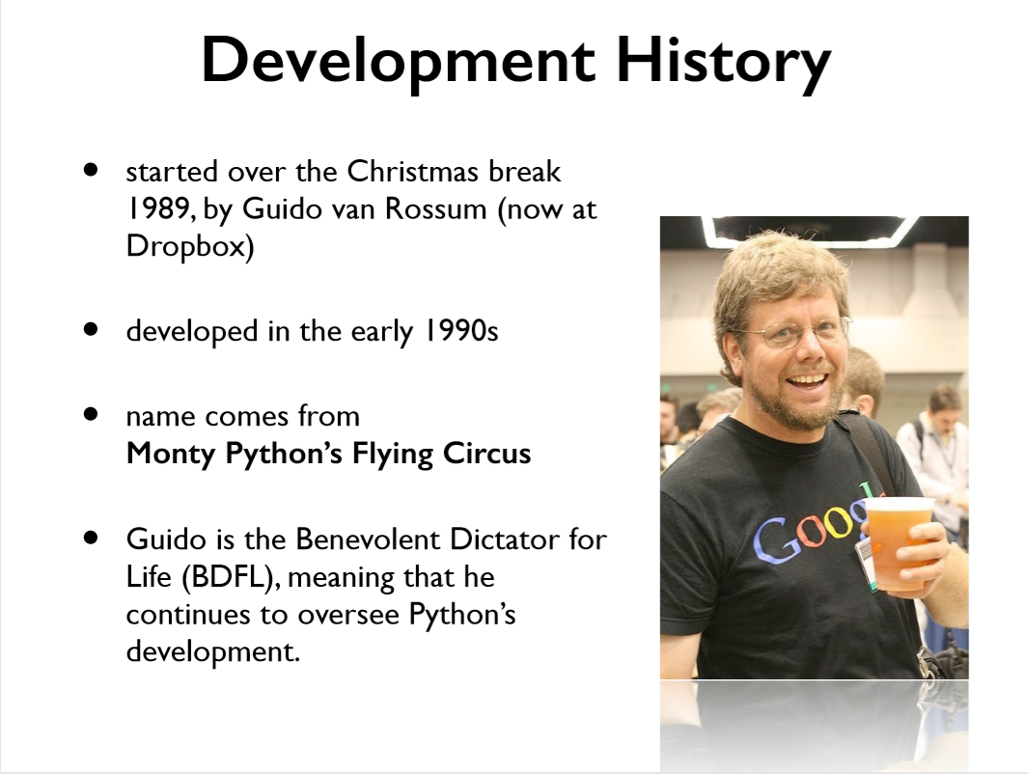

Slide 24
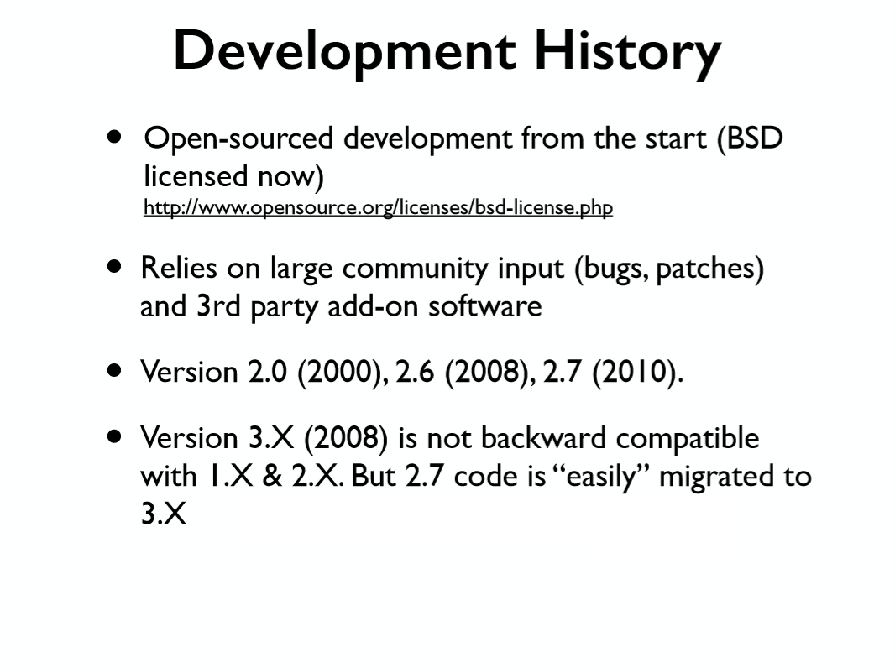

Slide 25
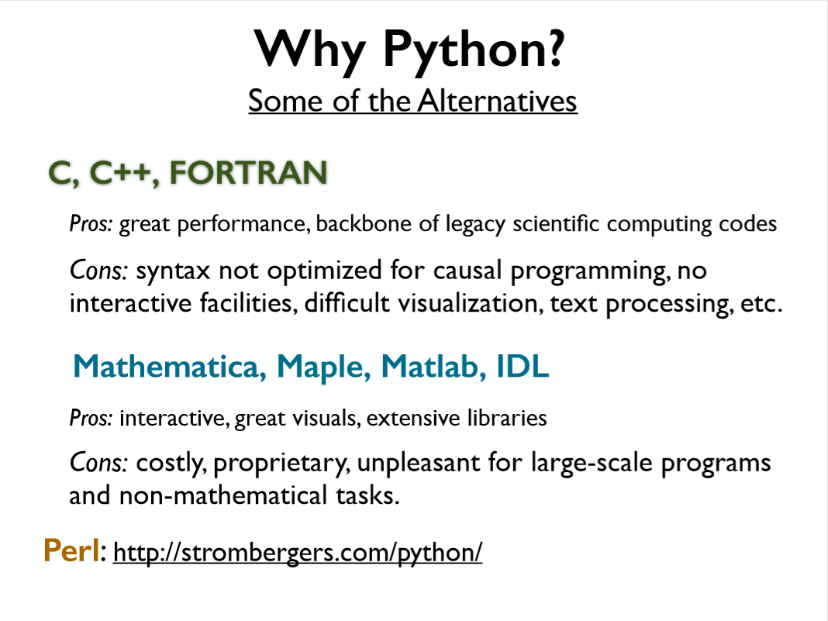

Slide 26
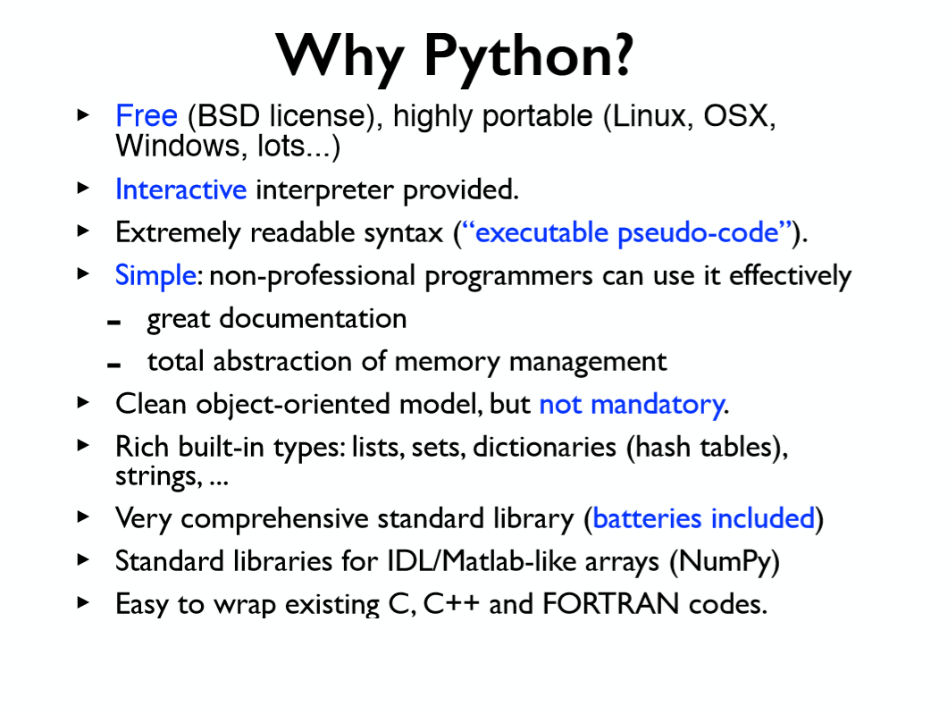

Slide 27
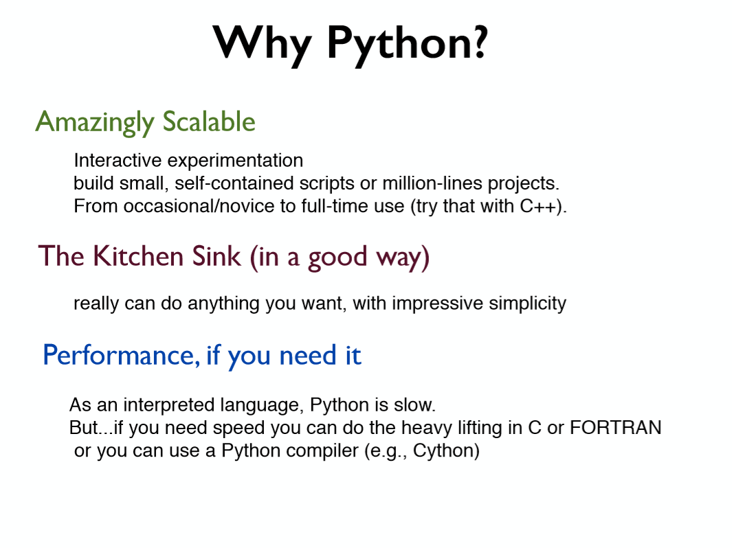

Slide 28
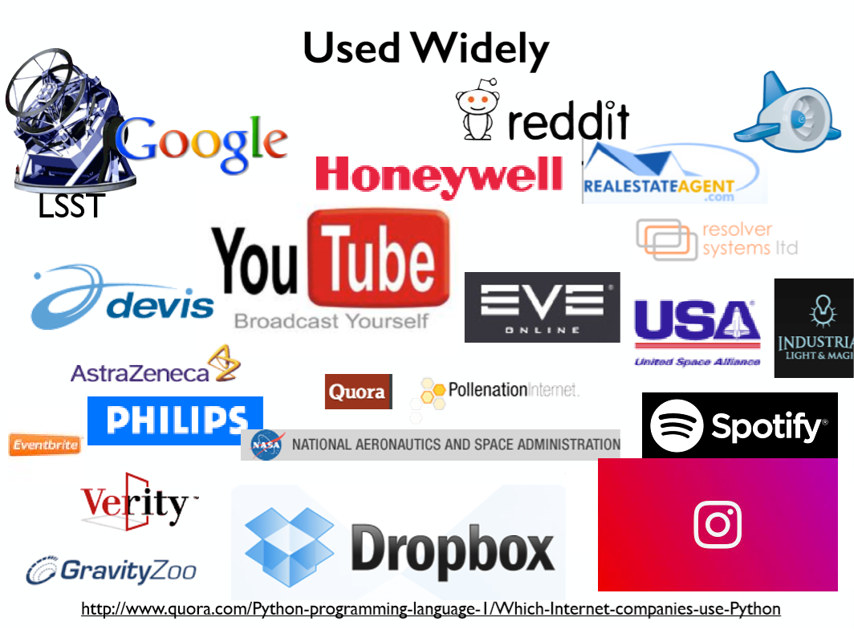

Slide 29
Boot-camp today and tomorrow
Visualization tools (matplotlib)
Let us practice:
Naive Matmul + bootcamp for beginners
Bifurcation map (Logistic map)
Julia set
Schelling model (cellular automata)
Spectrogram (wavelet for additional points)

Slide 30
Visualization tools
Matplotlib:
matplotlib.pyplot
matplotlib.animation
matplotlib.cm
Some other options:
seaborn
pyqtgraph

Slide 31
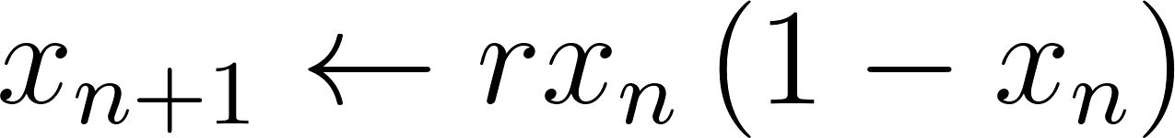

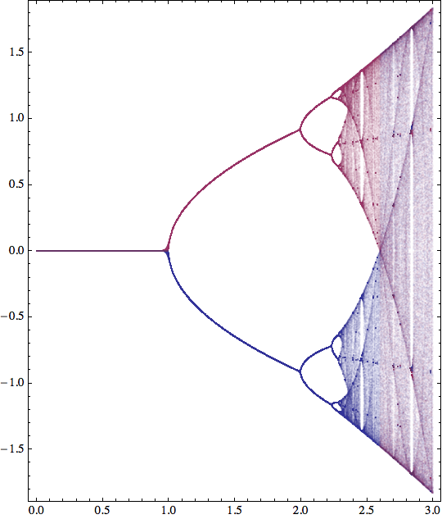
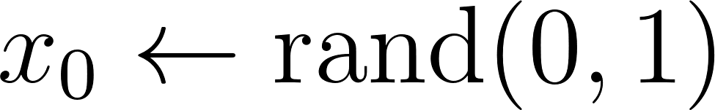


Task 1. Bifurcation map

Slide 32
Task 1. Bifurcation map
Step-by-step guide:
implement the map, plot the evolution of x
play around with values of r, see the change of evolution
then create a linspace of r’s, for every r save last “m” values of x after first “n” values (can be m=200, x=200), play around with values
Get the bifurcation map
vizualize the evolution (play around)
if you are interested - describe real physical systems that exhibit bifurcation

Slide 33
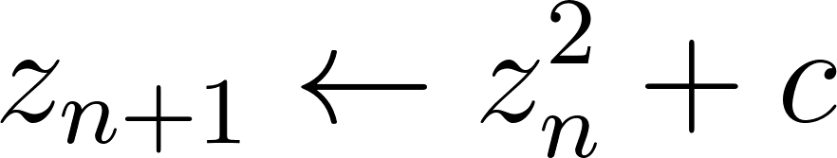
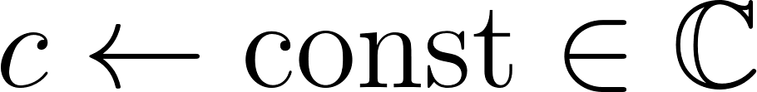
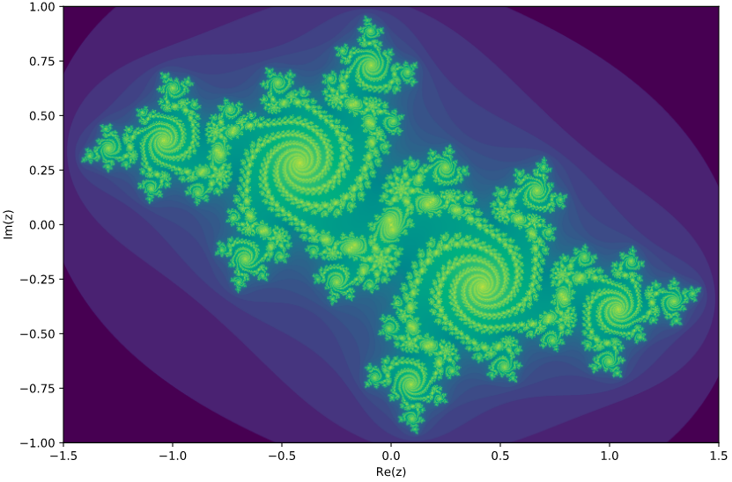


Task 2. Julia set

Slide 34
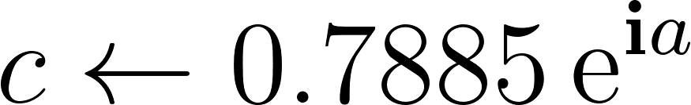
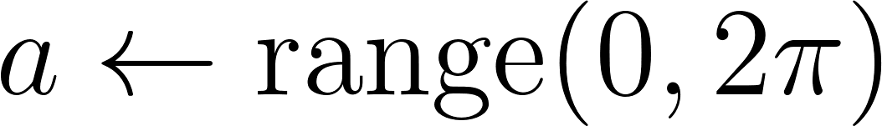

Task 2. Julia set – 2

Slide 35
Task 2. Julia set
Step-by-step guide:
fix a value of C (can be 0)
implement the map, plot the evolution of z (Re(z), Im(z))
play around with values of z0, see the change of evolution
for a given z0 if the sequence converges use black color, if it exponentially diverges use white color, if it starts jumping between “n” values use different colors
plot the Julia set
C=0 - Mandelbrot set

Slide 36
Question?
Julia set is self-similar (fractal)
Mandelbrot set is self-similar (fractal)
What is B in:
Benua B. Mandelbrot?

Slide 37
Task 3. Schelling’s Model
Suppose there are two types of agents: X and O. Two populations of the two agent types are initially placed into random locations of a neighborhood represented by a grid. After placing all the agents in the grid, each cell is either occupied by an agent or is empty.
Now we must determine if each agent is satisfied with its current location. A satisfied agent is one that is surrounded by at least t percent of agents that are like itself. This threshold t is one that will apply to all agents in the model.
When an agent is not satisfied, it can be moved to any vacant location in the grid. Any algorithm can be used to choose this new location. For example, a randomly selected cell may be chosen, or the agent could move to the nearest available location.
All dissatisfied agents must be moved in the same round. After the round is complete, a new round begins, and dissatisfied agents are once again moved to new locations in the grid.

Slide 38
Task 3. Schelling’s Model
Segregation model (black and white households)
map is large (i.e. 100x100 with periodic boundaries)
each household on a map has 8 neighbours
the agent decides to randomly move if less than R (you can change that) neighbours are of the same color
I want to move
I stay

Slide 39
Task 3. Schelling’s Model
Segregation model (black and white households)
map is large (i.e. 100x100 with periodic boundaries)
each household on a map has 8 neighbours
the agent decides to randomly move if less than R*8 (you can change that) neighbours are of the same color
Steps:
Randomize the map with half white/half black
define the value of R (0, ⅛, 2/8, ⅜, 4/8, ⅝,6/8,⅞, 1)
start the game
on each step for each cell find out if the cell wants to move - this cell is now on the market (considered free for moving in)
after you finished with the whole map - cells that want to move can move into free cells
repeat the whole procedure

Slide 40
